Slide 1
Decision Support and Business Intelligence Systems
(9th Ed., Prentice Hall)
Chapter 5:
Data Mining for Business Intelligence

Slide 2
Why Data Mining?
More intense competition at the global scale
Recognition of the value in data sources
Availability of quality data on customers, vendors, transactions, Web, etc.
Consolidation and integration of data repositories into data warehouses
The exponential increase in data processing and storage capabilities; and decrease in cost
Notes:
exponentialمتسارع

Slide 3


Definition of Data Mining
The nontrivial (meaning involved) process of identifying valid, novel, potentially useful, and ultimately understandable patterns in data stored in structured databases. - Fayyad et al., (1996)
Keywords in this definition: Process, nontrivial, valid, novel, potentially useful, understandable.
Data mining: a misnomer?
Other names: knowledge extraction, pattern analysis, knowledge discovery, information harvesting, pattern searching, data dredging,…
Notes:
Harvestingحصاد
data dredgingتجريف البيانات

Slide 4
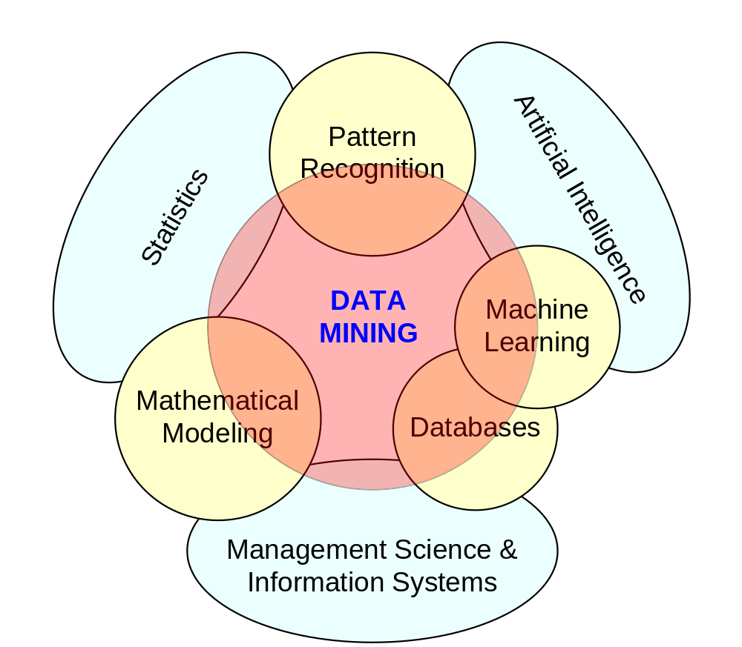
Data Mining at the Intersection of Many Disciplines

Slide 5
Data Mining Characteristics/Objectives
Source of data for DM is often (but not always) a consolidated data warehouse
DM environment is usually a client-server or a Web-based information systems architecture
Data is the most critical ingredient for DM which may include soft/unstructured data
The miner is often an end user
Striking it rich requires creative thinking
Data mining tools’ capabilities and ease of use are essential (Web, Parallel processing, etc.)

Slide 6
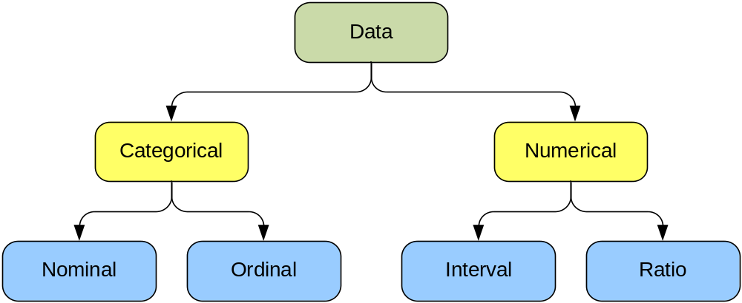
Data in Data Mining
Data: a collection of facts usually obtained as the result of experiences, observations, or experiments
Data may consist of numbers, words, images, …
Data: lowest level of abstraction (from which information and knowledge are derived)
DM with different data types.

Slide 7
Data Types in Data Mining
  Categorical Data (Specific grouping : Categorical Variables: Discrete, not calculable, no fraction but sub groups
  (Examples: race, sex, age group, education levels)
  Nominal:
    (marital status: 1. single, 2. married, 3. Widowed, 4. divorced
    Performance rating: 1. poor, 2. acceptable, 3. good, 4. Excellent, 5, Exemplary )
  Ordinal:
    (credit: high, medium, low,
    Age: child, young, middle age, old
    Education: high school, JC, undergrad, graduate)
Numerical Data ( numeric, can be continuous, can have fractions)
  (Credit score,
  (Age: in yeas
  Interval (scale) data
    (temperature: 0-100 Celsius ~ 32-212 Fahrenheit)
    (Customer inter-arrival time)
  Ratio data
    (mass, angle, energy – relative to a non-arbitrary base: absolute zero -273.15 Celsius)
  -
  Time /date
  Text
  Image
  audio

Slide 8
What Does DM Do?
DM extract patterns from data
  Pattern? A mathematical (numeric and/or symbolic) relationship among data items
Types of patterns
  Association (dipper & baby food)
  Prediction (weather forecasting)
  Cluster (segmentation) [age-group behavior, certain crime location and demographic]
  Sequential (or time series) relationships [does drug use leads to steeling?]

Slide 9
Data Mining Tasks (cont.)
Time-series forecasting
  Part of sequence or link analysis?
Visualization
  In connection to any data mining task
Types of DM
  OLD: Hypothesis-driven data mining
  New: Discovery-driven data mining
  (the foundation of machine-learning)

Slide 10
Data Mining Applications
Customer Relationship Management
  Maximize return on marketing campaigns
  Improve customer retention (churn analysis)
  Maximize customer value (cross-, up-selling)
  Identify and treat most valued customers
Banking and Other Financial
  Automate the loan application process
  Detecting fraudulent transactions
  Maximize customer value (cross-, up-selling)
  Optimizing cash reserves with forecasting

Slide 11
Data Mining Applications (cont.)
Retailing and Logistics
  Optimize inventory levels at different locations
  Improve the store layout and sales promotions
  Optimize logistics by predicting seasonal effects
  Minimize losses due to limited shelf life
Manufacturing and Maintenance
  Predict/prevent machinery failures
  Identify anomalies in production systems to optimize the use manufacturing capacity
  Discover novel patterns to improve product quality

Slide 12
Data Mining Applications
Brokerage and Securities Trading
  Predict changes on certain bond prices
  Forecast the direction of stock fluctuations
  Assess the effect of events on market movements
  Identify and prevent fraudulent activities in trading
Insurance
  Forecast claim costs for better business planning
  Determine optimal rate plans
  Optimize marketing to specific customers
  Identify and prevent fraudulent claim activities

Slide 13
Data Mining Applications (cont.)
Computer hardware and software
Science and engineering
Government and defense
Homeland security and law enforcement
Travel industry
Healthcare
Medicine
Entertainment industry
Sports
Etc.
Highly popular application areas for data mining

Slide 14
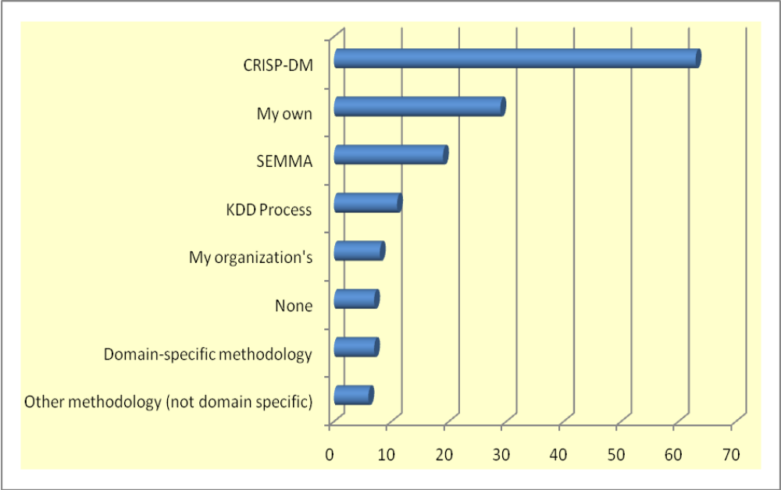
Data Mining Process
Most common standard processes:
  CRISP-DM (Cross-Industry Standard Process for Data Mining)
  SEMMA (Sample, Explore, Modify, Model, and Assess)
  KDD (Knowledge Discovery in Databases)

Slide 15
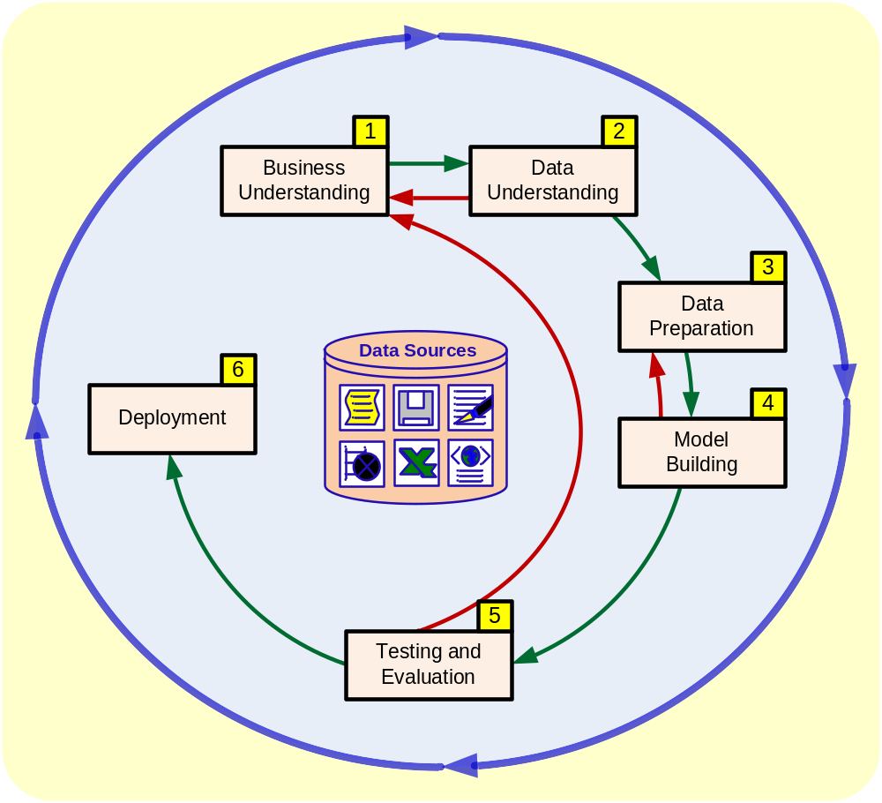
Data Mining Process: CRISP-DM

Slide 16
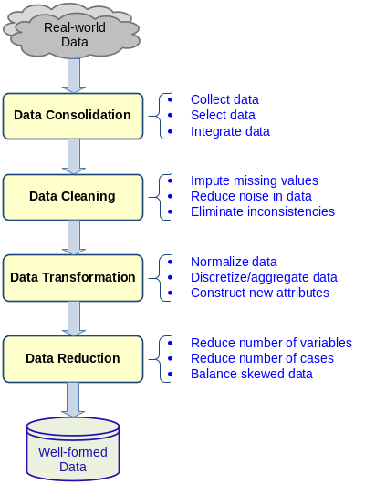
Data Mining Process: CRISP-DM
Step 1: Business Understanding
(the goal of the mining? Customer attrition, why?)
Step 2: Data Understanding
( * What data are valuable -- ‘abstraction’? “ )
(* Recall: Ayati: barrier of observability and measurability” )
(*Retail: female-summer clothing line:
“female customer data: e.g. zip-code,
credit card, age group, etc.?)
Step 3: Data Preparation (!)
See next slide
Accounts for ~85% of total project time

Slide 17
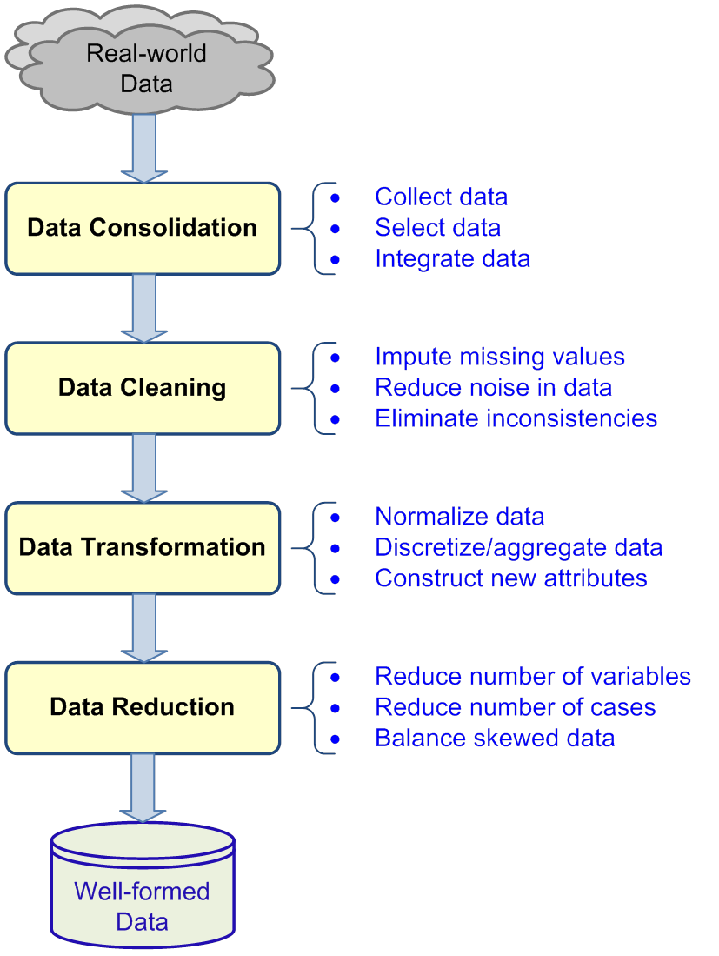
Data
Preparation
–
A Critical
DM Task

Slide 18
Data Mining Process: CRISP-DM (con’t)
Step 4: Model Building (means using a variety of methods)
Step 5: Testing and Evaluation
Step 6: Deployment
The process is highly repetitive and experimental (DM: art versus science?)

Slide 19
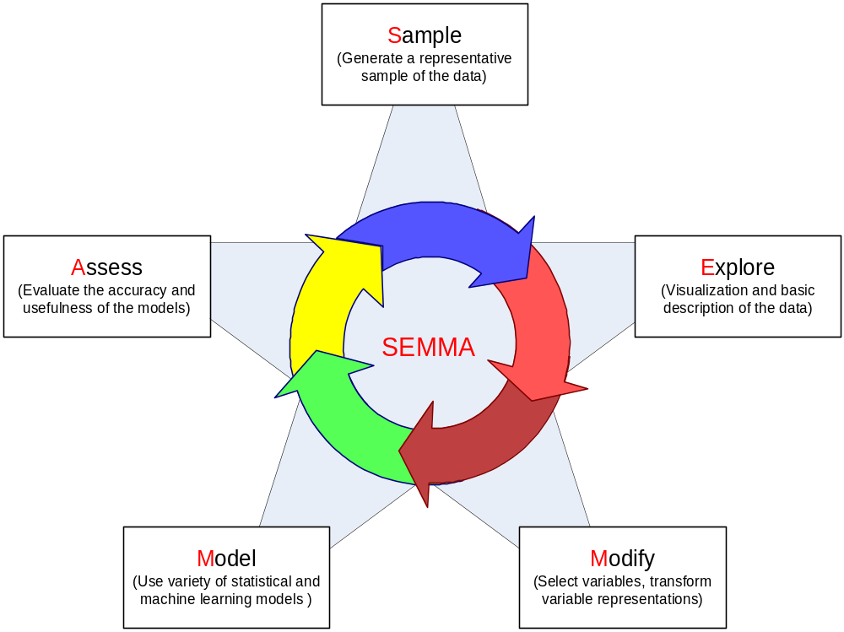
Data Mining Process: SEMMA

Slide 20
Decision Trees
Employs the divide and conquer method
Recursively divides a training set until each division consists of examples from one class
  Create a root node and assign all of the training data to it
  Select the best splitting attribute
  Add a branch to the root node for each value of the split. Split the data into mutually exclusive subsets along the lines of the specific split
  Repeat the steps 2 and 3 for each and every leaf node until the stopping criteria is reached
A general algorithm for decision tree building

Slide 21
Predictive: Decision Tree*
Identify the factors driving customer behavior and predict future behavior
 | Customer | Income | Age | Credit Rating | Etc. | Buying Behavior
Customers - Historical Data (query) | Mick Jones | $ 100000 | 48 | Excellent | … | Yes
 | Elton Brown | $ 130000 | 22 | Fair | … | No
 | Jack Turner | $ 118000 | 36 | Excellent | … | Yes
 | Etc. | … | … | … | … | …
How will other Customers behave? New Data (query) | Willie Nelson | $ 165000 | 34 | Fair | …
 | Carol Lee | $ 80000 | 63 | Excellent | …
 | Etc. | … | … | … | …
?
?
?
*Ayati: This example shows the common features of Decision Tree and Decision Table, which is the underlying principle of Expert Systems

Slide 22
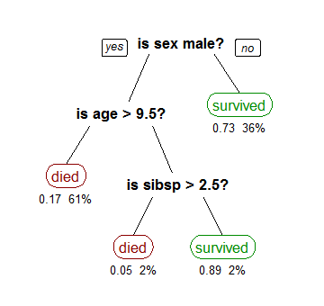
A tree showing survival of passengers on the Titanic ("sibsp" is the number of spouses or siblings aboard). The figures under the leaves show the probability of survival and the percentage of observations in the leaf.
Source: Wikipedia.org

Slide 23
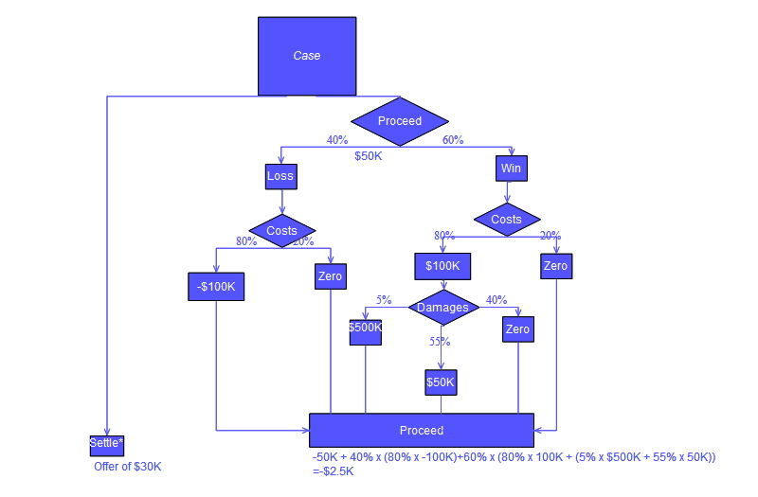
Source: Wikipedia.org

Slide 24
Cluster Analysis for Data Mining
Used for automatic identification of natural groupings of things
Part of the machine-learning family
Employ unsupervised learning
Learns the clusters of things from past data, then assigns new instances
There is not an output variable
Also known as segmentation

Slide 25
Cluster Analysis for Data Mining
Clustering results may be used to
  Identify natural groupings of customers
  Identify rules for assigning new cases to classes for targeting/diagnostic purposes
  Provide characterization, definition, labeling of populations
  Decrease the size and complexity of problems for other data mining methods
  Identify outliers in a specific domain (e.g., rare-event detection)

Slide 26
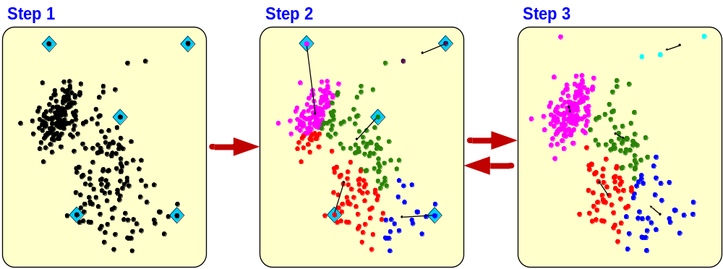
Cluster Analysis for Data Mining - k-Means Clustering Algorithm

Slide 27
Association Rule Mining
A very popular DM method in business
Finds interesting relationships (affinities) between variables (items or events)
Part of machine learning family
Employs unsupervised learning
There is no output variable
Also known as market basket analysis
Often used as an example to describe DM to ordinary people, such as the famous “relationship between diapers and beers!”

Slide 28
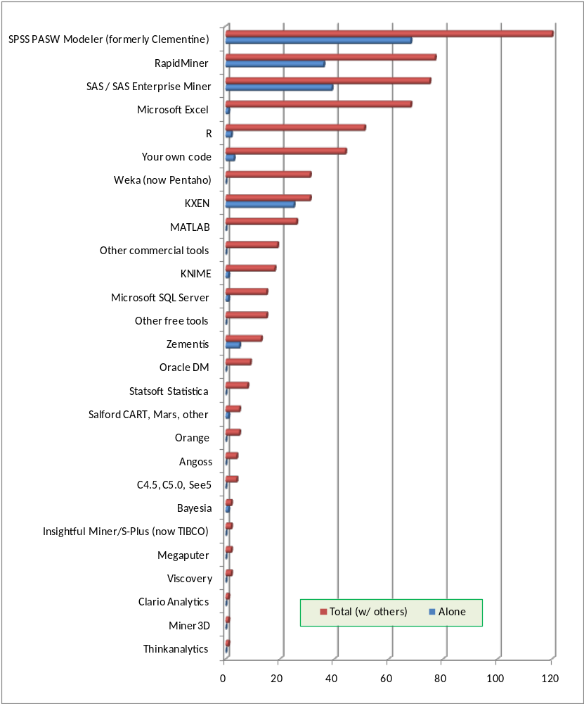
Data Mining
Software
Commercial
  SPSS - PASW (formerly Clementine)
  SAS - Enterprise Miner
  IBM - Intelligent Miner
  StatSoft – Statistical Data Miner
  … many more
Free and/or Open Source
  Weka
  RapidMiner…
Source: KDNuggets.com, May 2009

Slide 29
Data Mining Myths
Data mining …
  provides instant solutions/predictions
  is not yet viable for business applications
  requires a separate, dedicated database
  can only be done by those with advanced degrees
  is only for large firms that have lots of customer data
  is another name for the good-old statistics

Slide 30
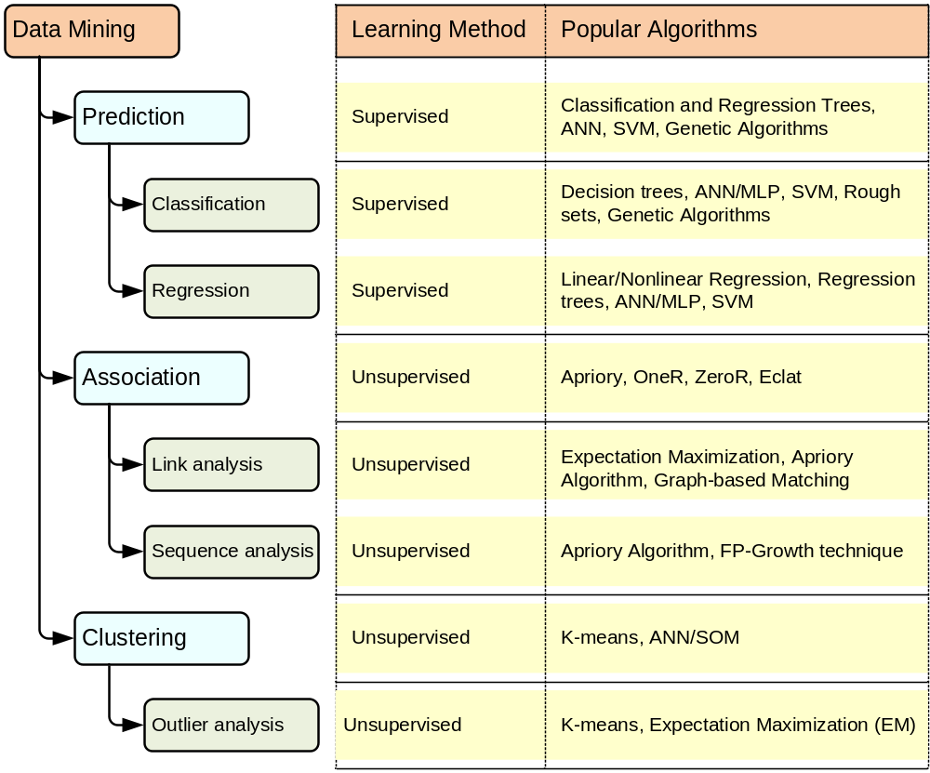
A Taxonomy for Data Mining Tasks

Slide 31
End of the Chapter
Questions / Comments…

